Slide 1
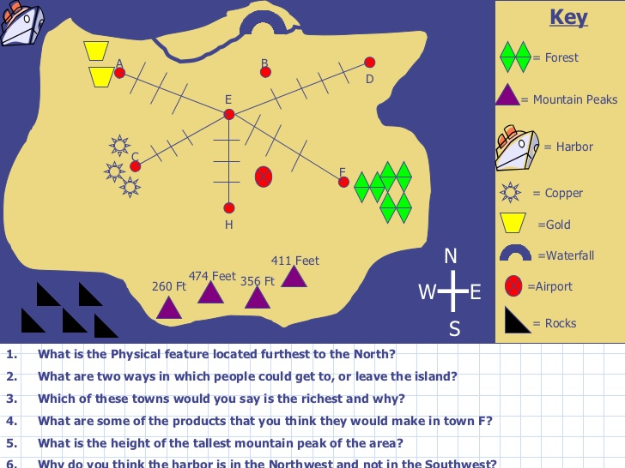
LET’S SEE HOW WE WILL SOLVE THIS:-

Slide 2
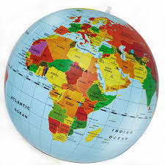

Chapter 2
Globe : Latitudes and Longitudes

Slide 3
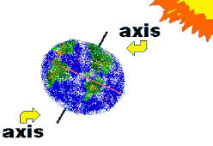
AXIS OF THE EARTH
The axis of the Earth is an imaginary line drawn through the North Pole and the South Pole.

Slide 4
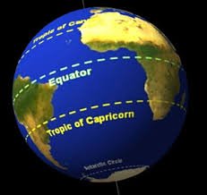
EQUATOR
Equator is a line notionally drawn on the earth equidistant from the poles, dividing the earth into northern and southern hemispheres and constituting the parallel of latitude 0°.

Slide 5
Latitudes / parallels
The angular distance of a place north or south of the earth's equator, usually expressed in degrees and minutes.
Latitude is an angle, which ranges from 0° at the Equator to 90° (North or South) at the poles. Lines of constant latitude, or parallels, run east–west as circles parallel to the equator

Slide 6
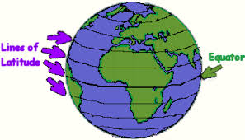
LINES OF LATITUDES / PARALLELS

Slide 7
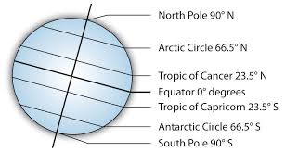
THE MAIN LATITUDES
THERE ARE 181 LATITUDES.
LATITUDES DIVIDE THE EARTH INTO HEAT-ZONES.
THE SIZE OF THE LATITUDES REDUCES AS THEY MOVE TOWARDS THE POLES

Slide 8
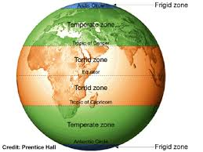
HEAT ZONES – 5 ZONES

Slide 9
Some work to be done
Why do you think the Earth is divided into heat zones?
Write three points each on the heat zones.

Slide 10
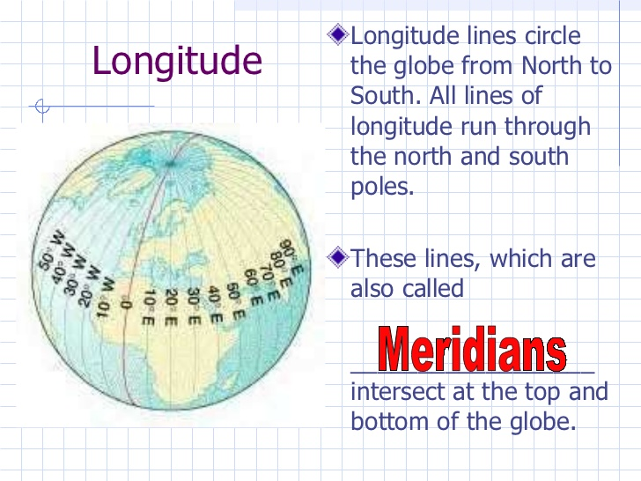
Longitudes/Meridians

Slide 11
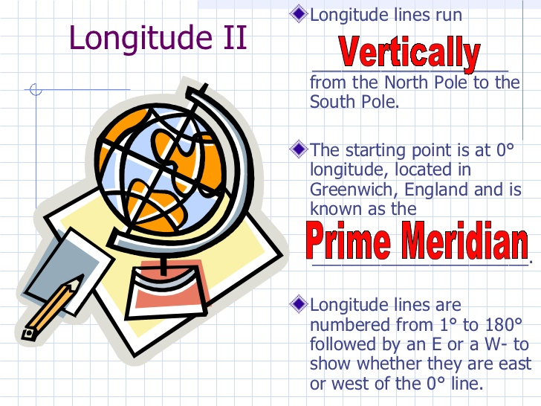
MORE ON LONGITUDES

Slide 12
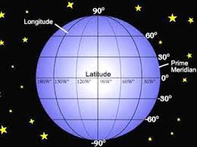
The geographic grid is a system designed to pinpoint any location on Earth by laying a vertical and horizontal grid over the Earth's layout. The vertical lines are called the longitude and the horizontal lines are the latitude. The intersection of these two points determines any exact location.
THE GEO-GRAP-HIC GRID

Slide 13
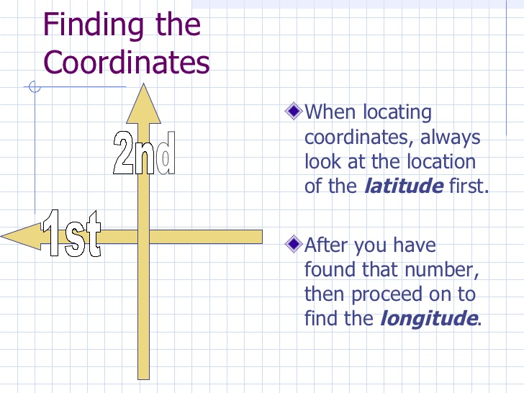
HELPFUL TIPS

Slide 14
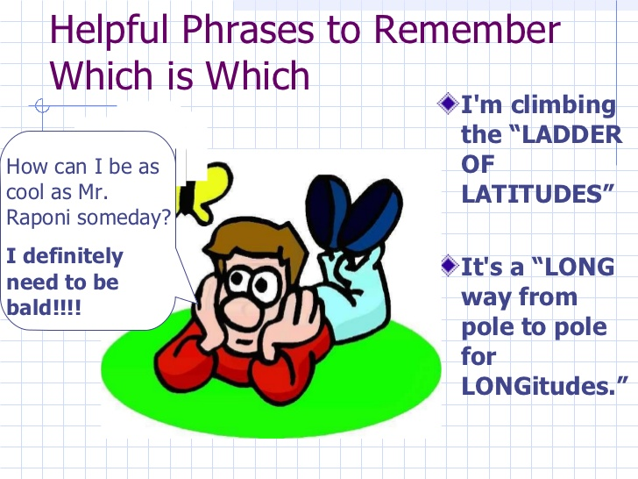
MORE SUCH TIPS

Slide 15

TO BE CONTINUED-TIME ZONES

